Slide 1
Floating Point

Slide 2
Topics
Store and access FP values
FP Movement and Conversion Operations
FP Code in Procedures
FP Arithmetic Operations
Defining and Using FP Constants
Using Bitwise Operations in FP code
FP Comparison Operations
Suggested Reading: 3.11

Slide 3
X86-64 Floating-point Architecture
Pentium/MMX 1997, SIMD
  Single instruction, multiple data
  Support graphics and image processing
  MMX, SSE, and AVX
A new sets of “MM” registers
  MM (64bits) for MMX
  XMM (128bits) for SSE
  YMM (256bits) for AVX

Slide 4
X86-64 Floating-point Architecture
Pentium4/SSE2 2000
  A new scalar floating-point mode
  A set of registers and instructions
  X86-64 FP is based on SSE or AVX
ICS book introduces AVX2
  Core i7 Haswell, 2013r
  Gcc command-line parameter: -mavx2

Slide 5
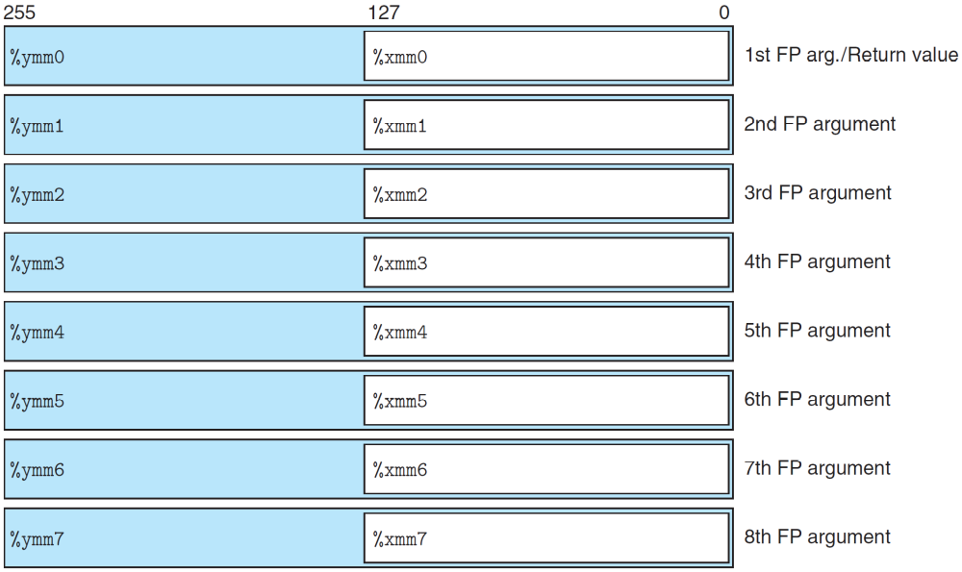
FP media registers

Slide 6
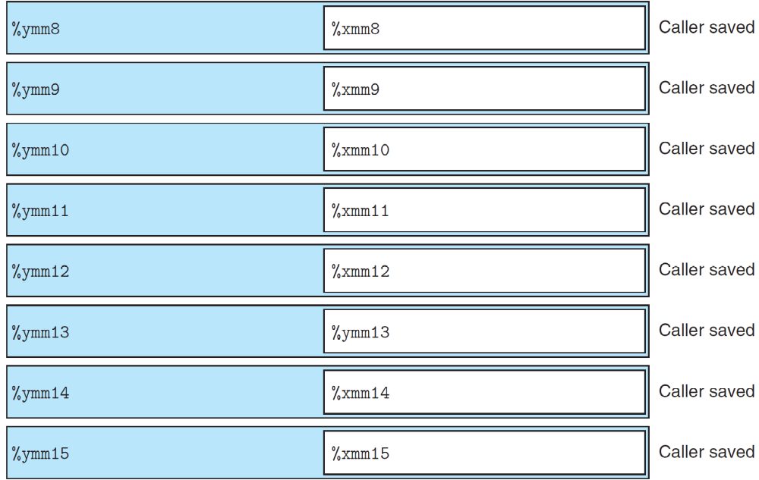
FP Media registers

Slide 7
AVX FP registers
16 YMM registers
  %ymm0-%ymm15, 256 bits
  FP instrs only use the low-order 32 bits (for float) and 64 bits (for double) by %xmm0-%xmm15

Slide 8
FP Movement Operations
Transfer values between memory and registers, as well as pairs of registers
Instruction | Source | Dest | Description
vmovss | M₃₂ | XMM | Move single precision
vmovss | XMM | M₃₂ | Move single precision
vmovsd | M₆₄ | XMM | Move double precision
vmovsd | XMM | M₆₄ | Move double precision
vmovaps | XMM | XMM | Move aligned, packed single precision
vmovapd | XMM | XMM | Move aligned, packed double precision

Slide 9
FP Movement Operations
float float_mov(float v1, float *src, float *dst){
float v2 = *src;
*dst = v1;
return v2;
}
float float_mov(float v1, float *src, float *dst)
v1 in %xmm0, src in %rdi, dst in %rsi
float_mov:
vmovaps %xmm0, %xmm1 Copy v1
vmovss (%rdi), %xmm0 Read v2 from src
vmovss %xmm1, (%rsi) Write v1 to dst
ret Return v2 in %xmm0

Slide 10
Two-operand FP Conversion Operations
Converting FP data to integers
  Round values toward zero
Instruction | Source | Dest | Description
vcvttss2si | XMM/M₃₂ | R₃₂ | Convert with truncation single precision to integer
vcvttsd2si | XMM/M₆₄ | R₃₂ | Convert with truncation double precision to integer
vcvttss2siq | XMM/M₃₂ | R₆₄ | Convert with truncation single precision to quad word integer
vcvttsd2siq | XMM/M₆₄ | R₆₄ | Convert with truncation double precision to quad word integer

Slide 11
Three-operand FP Conversion Operations
Converting integer data to FPs
  Ignore the second source
  e.g., vcvtsi2sdq %rax, %xmm1, %xmm1
Instruction | Source1 | Source2 | Dest | Description
vcvttsi2ss | M₃₂/R₃₂ | X | X | Convert integer to single precision
vcvttsi2sd | M₃₂/R₃₂ | X | X | Convert integer to double precision
vcvttsi2ssq | M₆₄/R₆₄ | X | X | Convert quad word integer to single precision
vcvttsi2ssq | M₆₄/R₆₄ | X | X | Convert quad word integer to double precision

Slide 12
FP Conversion Instructions
double fcvt(int i, float *fp, double *dp, long *lp){
float f = *fp; double d = *dp; long l = *lp;
*lp = (long)d; *fp = (float)i; *dp = (double)l;
return (double)f;
}
float fcvt(int i, float *fp, double *dp, long *lp)
i in %edi, fp in %rsi, dp in %rdx, lp in %rcx
fcvt:
vmovss (%rsi), %xmm0 Get f = *fp
movq (%rcx), %rax Get l = *lp
vcvttsd2siq (%rdx), %r8 Get d = *dp
and convert to long
movq %r8, (%rcx) Store at lp

Slide 13
FP Conversion Instructions
double fcvt(int i, float *fp, double *dp, long *lp){
float f = *fp; double d = *dp; long l = *lp;
*lp = (long)d; *fp = (float)i; *dp = (double)l;
return (double)f;
}
vcvtsi2ss %edi, %xmm1, %xmm1 Convert i to float
vmovss %xmm1, (%rsi) Store at fp
vcvtsi2sdq %rax, %xmm1, %xmm1 Convert l to double
vmovsd %xmm1, (%rdx) Store at dp
The following two instructions convert f to double
vunpcklps %xmm0, %xmm0, %xmm0
vcvtps2pd %xmm0, %xmm0
ret Return f

Slide 14
FP Conversion Instructions
It should be
  vcvtss2sd %xmm0, %xmm0, %xmm1
Gcc generates the following
vunpcklps %xmm0, %xmm0, %xmm0
vcvtps2pd %xmm0, %xmm0

Slide 15
FP Code in Procedures
XMM registers are used for passing FP arguments to function and for returning FP values from them
  Up to eight FP arguments can be passed in XMM registers (%xmm0-%xmm7)
  Additional FP arguments can be passed on stack
  Function returns a floating-point value in %xmm0
  All XMM registers are caller saved

Slide 16
FP Code in Procedures
A function contains a combination of pointer, integer, and FP arguments
  Pointers and integers are passed in general-purpose registers
  FP values are passed in XMM registers
The mapping of arguments to registers depends on both their types and their ordering
double f1(int x, double y, long z)
double f2(double y, int x, long z)
x in %edi, y in %xmm0, and z in %rsi

Slide 17
FP Arithmetic Operations
One (S₁) or two (S₁, S₂) source operands and a destination operand D
  S₁ can be XMM register or a memory location
  S₂ and D must be XMM registers
Single | Double | Effect | Description
vaddss | vaddsd | D ← S₂ + S₁ | FP add
vsubss | vsubsd | D ← S₂ - S₁ | FP subtract
vmulss | vmulsd | D ← S₂ x S₁ | FP multiply
vdivss | vdivsd | D ← S₂ / S₁ | FP divide
vmaxss | vmaxsd | D ← max(S₂, S₁) | FP maximum
vminss | vminsd | D ← min(S₂, S₁) | FP minimum
sqrtss | sqrtsd | D ← S₁+ ^ (1/2) | FP square root

Slide 18
FP Arithmetic Operations
double funct(double a, float x, double b, int i){
return a*x – b/i;
}
double funct(double a, float x, double b, int i)
a in %xmm0, x in %xmm1, b in %xmm2, i in %edi
funct:
The following two instructions convert x to double
vunocklps %xmm1, %xmm1, %xmm1
vcvtps2pd %xmm1, %xmm1
vmulsd %xmm0, %xmm1, %xmm0 Multiply a by x
vcvtsi2sd %edi, %xmm1, %xmm1 Convert i to double
vdivsd %xmm1, %xmm2, %xmm2 Compute b/I
vsubsd %xmm2, %xmm0, %xmm0 Subtract from a*x
ret Return

Slide 19
Defining and Using FP Constants
AVX FP operations cannot have immediate values as operands
  Allocate and initialize memory for constant values
double cel2fahr(double temp){
return 1.8 * temp + 32.0;
}
.LC2:
Low-order of 1.8
.Long 3435973837
High-order of 1.8 .Long 1073532108
.LC3:
Low-order of 32.0
.Long 0
High-order of 32.0
.Long 1077936128
double cel2fahr(double temp)
temp in %xmm0
cel2fahr:
Multiply by 1.8
vmulsd .LC2(%rip), %xmm0, %xmm0
Add 32.0
vaddsd .LC3(%rip), %xmm0, %xmm0
ret

Slide 20
Using Bitwise Operations in FP Code
Single | Double | Effect | Description
vxorps | xorpd | D ← S₂ ^ S₁ | Bitwise EXCLUSIVE-OR
vandps | andpd | D ← S₂ & S₁ | Bitwise AND
double simple (...){
...
return 0.0;
}
simple:
...
vxorpd %xmm0, %xmm0, %xmm0
ret

Slide 21
FP Comparison Operations
Compare operands S₁ and S₂
  S₁ can be an XMM register or in memory
  S₂ must be XMM register
  Unordered: either operand is NaN
Instructions | CF | ZF | PF
Unordered | 1 | 1 | 1
S₂ < S₁ | 1 | 0 | 0
S₂ = S₁ | 0 | 1 | 0
S₂ > S₁ | 0 | 0 | 0
Instructions | Effect | Description
ucomiss S1, S2 | S₂ - S₁ | Compare single precision
ucomisd S1, S2 | S₂ - S₁ | Compare double precision

Slide 22
FP Comparison Operations
typedef enum {NEG, ZERO, POS, OTHER} range_t
range_t find_range(float x)
{
int result;
if (x < 0)
result = NEG;
else if (x == 0)
result = ZERO;
else if (x > 0)
result = POS;
else
result = OTHER;
return result;
}
range_t find_range(float x)
x in %xmm0
find_range:
vxorps %xmm1, %xmm1, %xmm1 Set %xmm1 = 0
vucomiss %xmm0, %xmm1 Compare 0:x
ja .L5 If >, goto NEG
vucomiss %xmm1, %xmm0 Compare x:0
jp .L8 If NaN, goto posornan

Slide 23
FP Comparison Operations
movl $1, %eax rsult = ZERO
je .L3 If =, goto done
.L8 posernan
vucomiss .LC0(%rip), %xmm0 Compare x:0
setbe %al Set result = NaN?1:0
movzbl %al, %eax Zero-extend
addl $2, %eax result += 2 (POS for
>0, OTHER for NaN)
ret Return
.L5 NEG:
movl $0, %eax result = NEG
.L3 done:
rep; ret Return

